Slide 1
Tableau Story Creation (Day – 8)
By Jerin Joseph

Slide 2
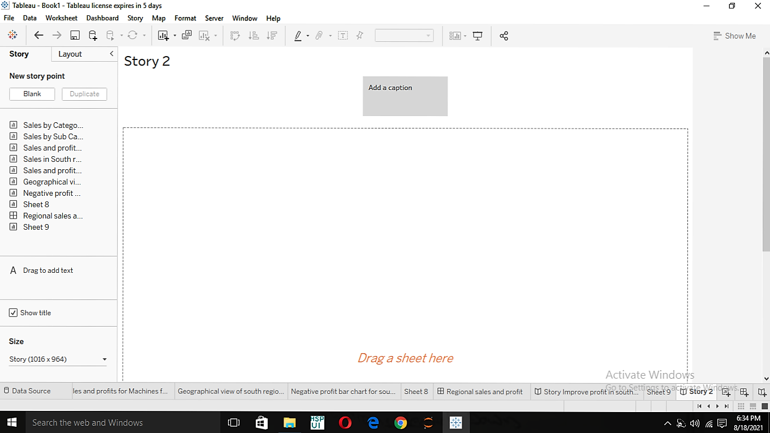
1) Create a story to present all your Insights to your team

Slide 3
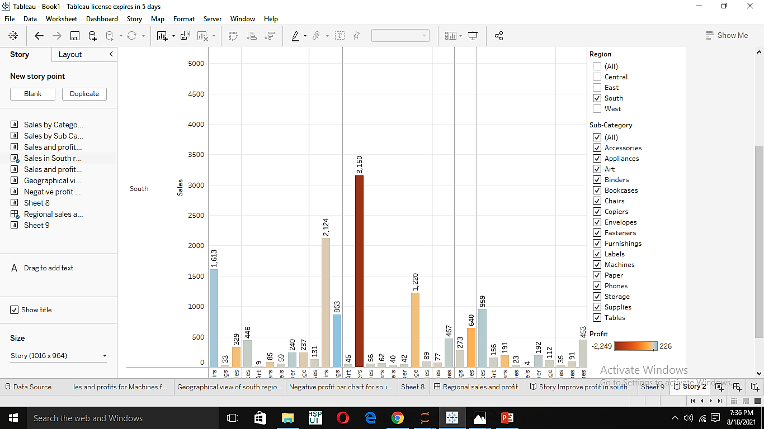
2) Show the “Sales in South” worksheet in your story

Slide 4
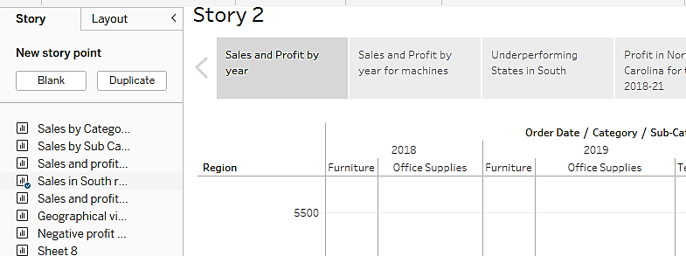
3) Add a Caption “ Sales and profit by year “ to this work sheet above

Slide 5
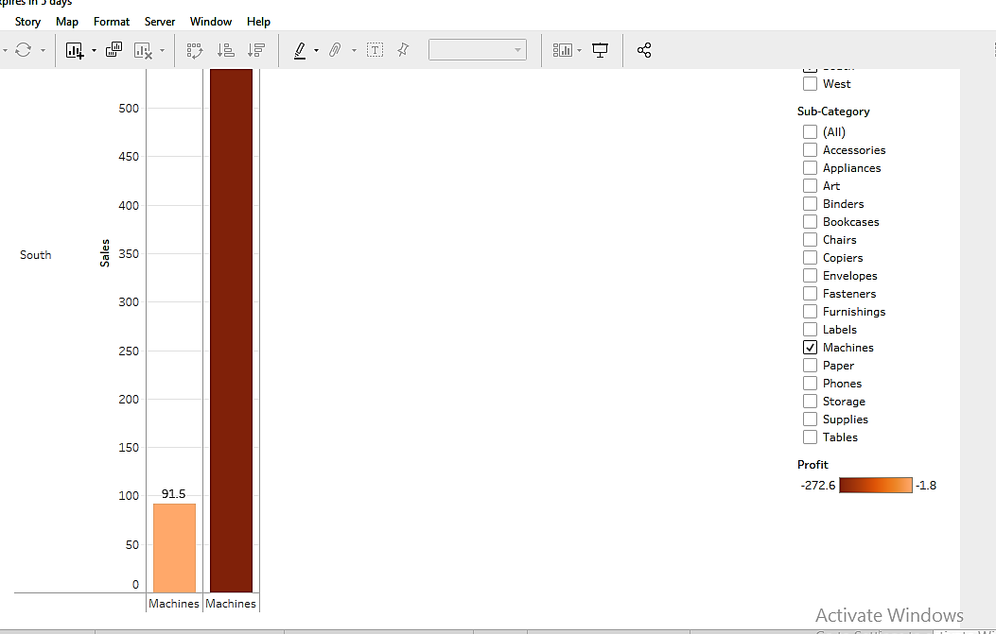
4) Duplicate the first caption and depict the story for Profit and sales for only “Machine” sub category

Slide 6
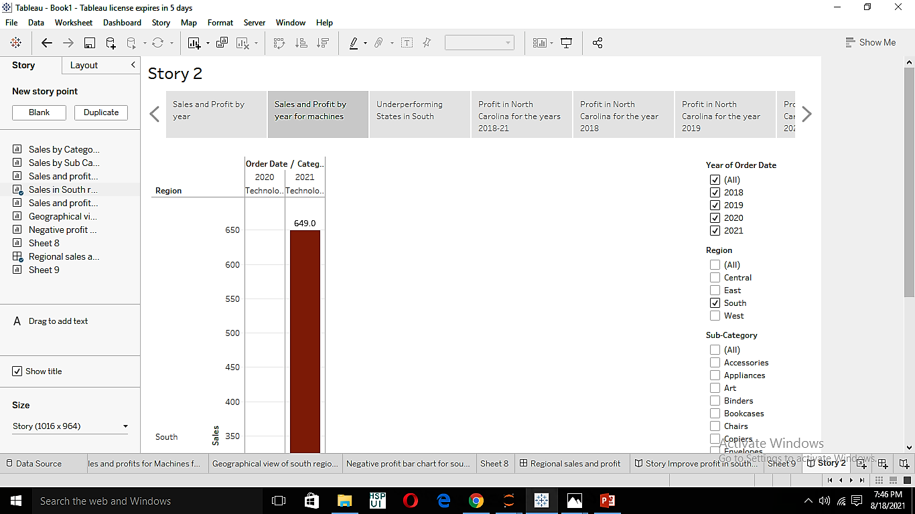
5) Add the caption as “ Sales & Profit by year for Machines”

Slide 7
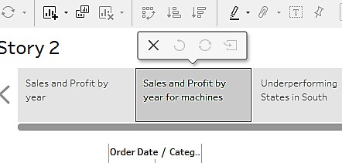
6) Check your story mini toolbar around the story point caption

Slide 8
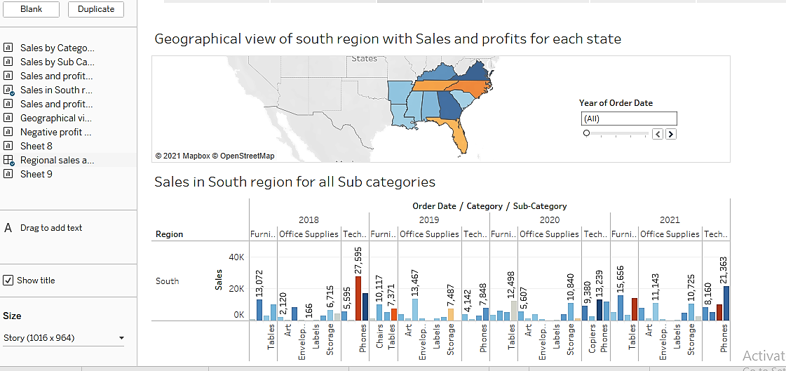
7) Select the blank in story pane and drag “Regional sales and profit” worksheet

Slide 9
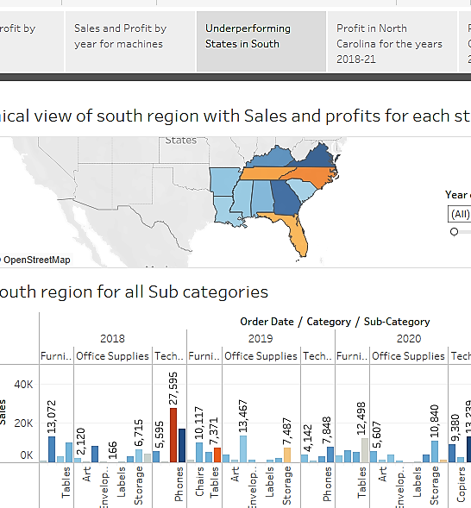
8) Add a caption as Underperforming states in south to this story

Slide 10
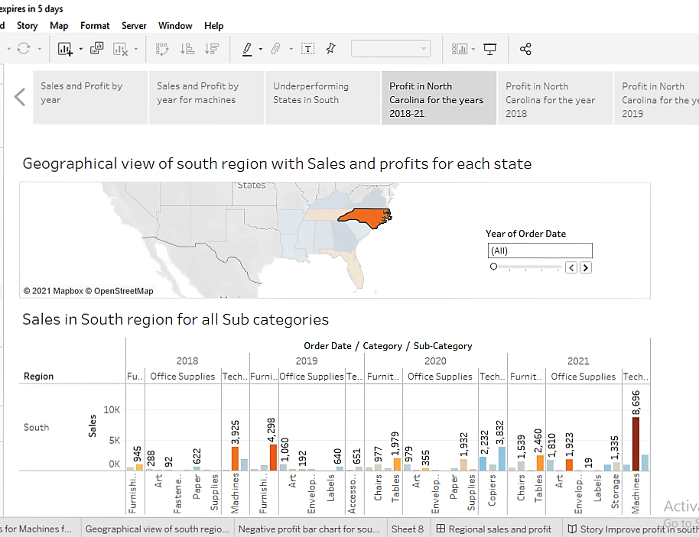
9, 10) Duplicate the above story and show the results for only North Carolina for all the years

Slide 11
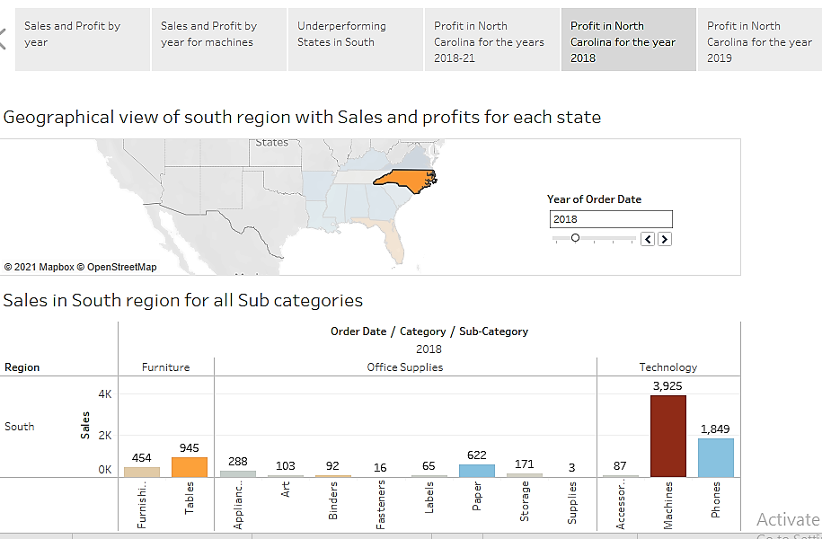
11) Show the result for North Carolina in 2018 only

Slide 12
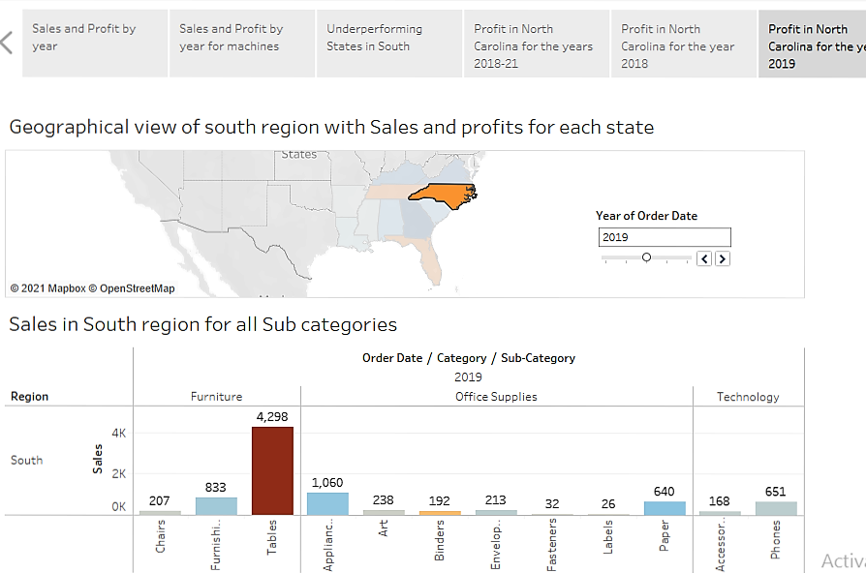
12) Show the result for North Carolina in 2019 only

Slide 13
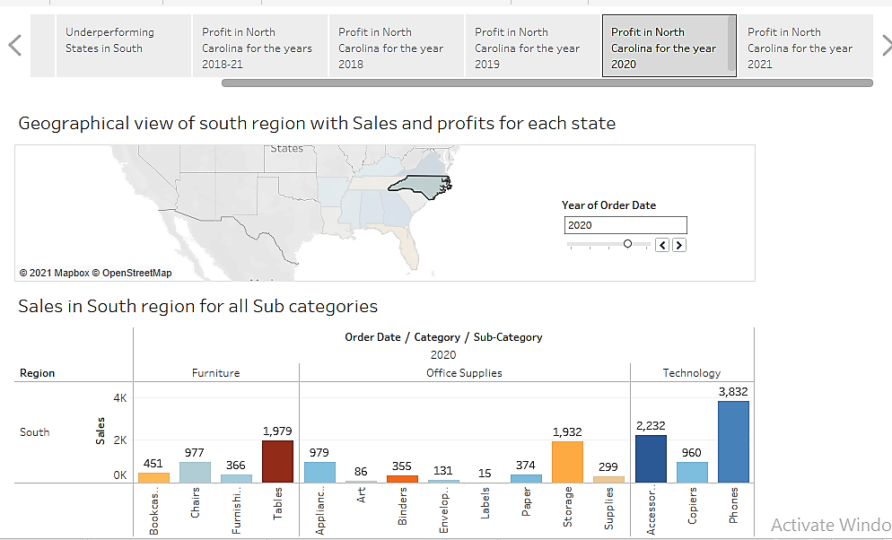
12) Show the result for North Carolina in 2020 only

Slide 14
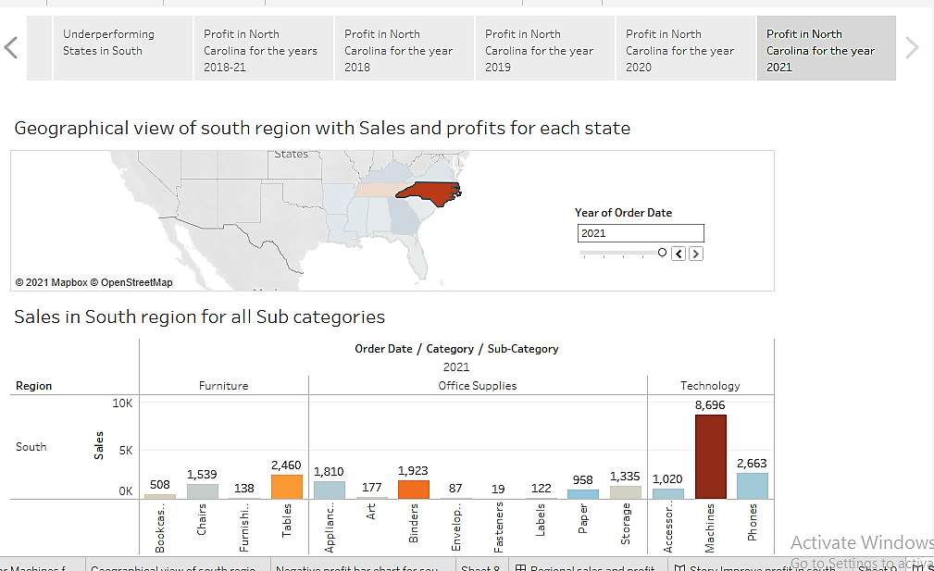
12) Show the result for North Carolina in 2021 only

Slide 15
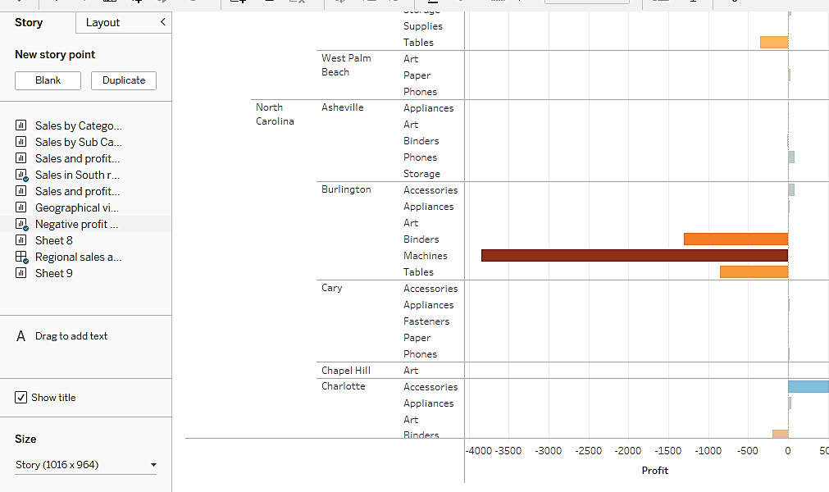
14) Drag the Negative profit bar graph by selecting Blank in story pane

Slide 16
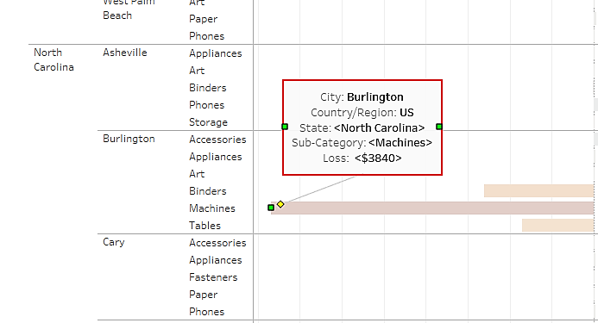
15)Create an Annotation box at Burlington bar graph

Slide 17
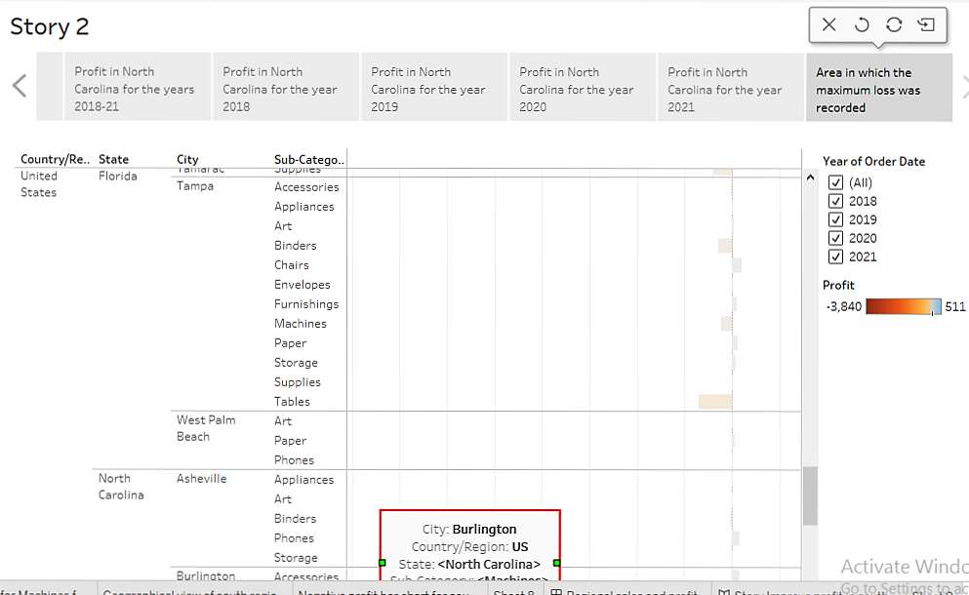
16) Add a caption to this story point

Slide 18
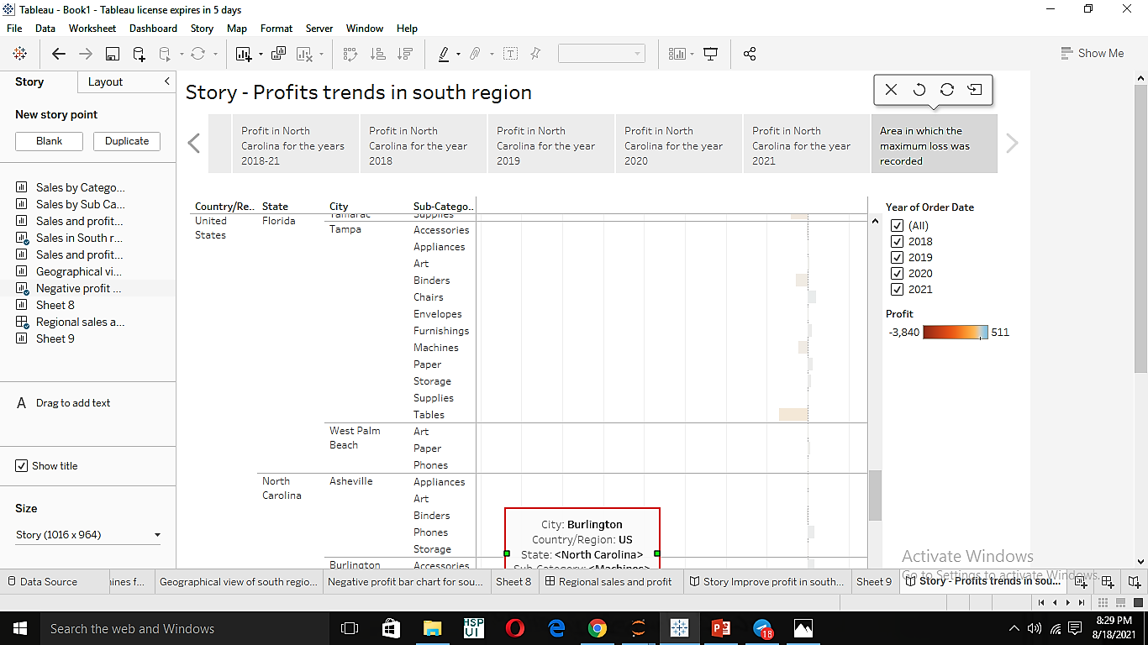
17) Add a title to your story

